Slide 1

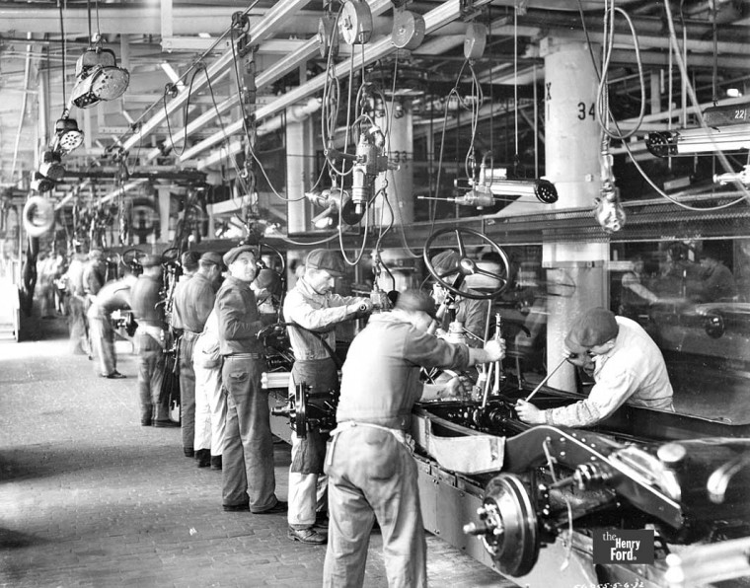
Introduction to threads
Data Decomposition
Task Decomposition

Slide 2
Process’s memory architecture
Stack
Declared inside functions/params
Created with new or malloc
Free Memory
Heap
Globals and static members
Static

Slide 3
A thread allows for concurrent execution in same process
Stack
Stack
Stack
Each thread runs a “function” which can call other functions.
pthread_create()
std::thread()
Free Memory
Thread1
Thread2
Heap
Heap
Static
Static

Slide 4
Threads in a process share a memory space
Each thread has its own PC and stack
Either thread can access heap/static space
One thread could access another thread’s stack variables if it could locate them
Each thread is independently schedulable
Stack
Stack
Thread1
Thread2
Heap
Static

Slide 5
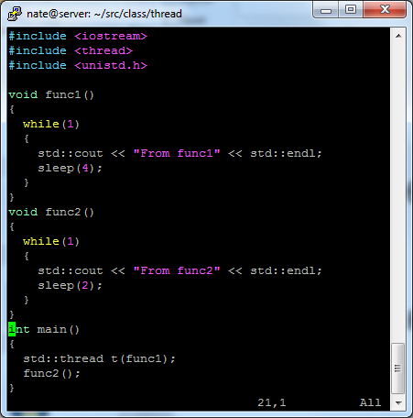
Let’s code
Start small
What is this going to do? Any guesses?

Slide 6
Let’s code – How far can we push this
Let’s access some stack variables
Lets access some heap variables
  Now do it from to threads
  Can we break things?
  Any odd behavior you observe
Can we pass in a method pointer?
What about a lambda or functor?

Slide 7
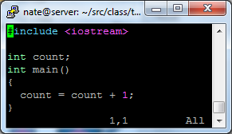
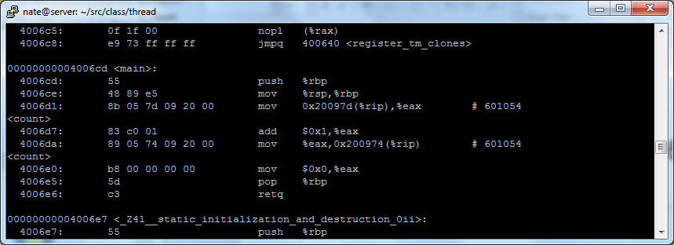
Let’s code – Why were we able to break it?
A line of source makes man lines of assembly
What if several threads multi-tasked this code?
Worlds simplest program

Slide 8
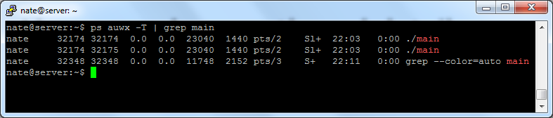
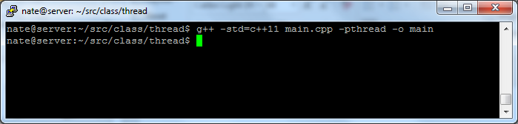
Linux can show us thread details
std::thread is built on top of pthreads

Slide 9
How do we move data between threads?
We really don’t have to
All memory is shared and we simply use it
Race conditions are real and significant
  More lectures to come on this topic

